Slide 1


Slide 2


Topic- Diabetes Prediction
Diabetes is a chronic disease that occurs when the pancreas is no longer able to make insulin, or when the body cannot make good use of the insulin it produces. Learning how to use Machine Learning can help us predict Diabetes. Let’s get started!
About this project :-
The objective of this project is to classify whether someone has diabetes or not. Dataset consists of several Medical Variables(Independent) and one Outcome Variable(Dependent). The independent variables in this data set are :-'Pregnancies', 'Glucose', 'BloodPressure', 'SkinThickness', 'Insulin','BMI', 'DiabetesPedigreeFunction', 'Age’. The outcome variable value is either 1 or 0 indicating whether a person has diabetes(1) or not(0).

Slide 3
About the Dataset
Pregnancies :- Number of times a woman has been pregnant
Glucose :- Plasma Glucose concentration of 2 hours in an oral glucose tolerance test
Blood Pressure :- Diastolic Blood Pressure (mm hg)
Skin Thickness :- Triceps skin fold thickness(mm)
Insulin :- 2 hour serum insulin(mu U/ml)
BMI :- Body Mass Index ((weight in kg/height in m)^2)
Age :- Age(years)
Diabetes Pedigree Function :-scores likelihood of diabetes based on family history)
Outcome :- 0 (doesn't have diabetes) or 1 (has diabetes)

Slide 4
Project Contents
Importing libraries
Loading and understanding the data​
EDA (Exploratory Data Analysis) and Preprocessing.
Train Test Split
Model building​
Logistic Regression
K Nearest Neighbors
Decision Tree
Random forest ​(Hyperparameter Tuning Using GridSearchCV)
Support Vector Machine
Extra Tree Classifier
Ada Boost Classifier
Gradient Boosting Classifier
XG Boost Classifier
Feature Importance​

Slide 5
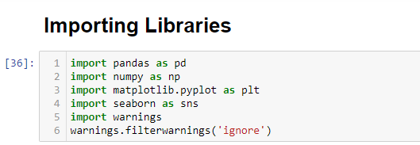
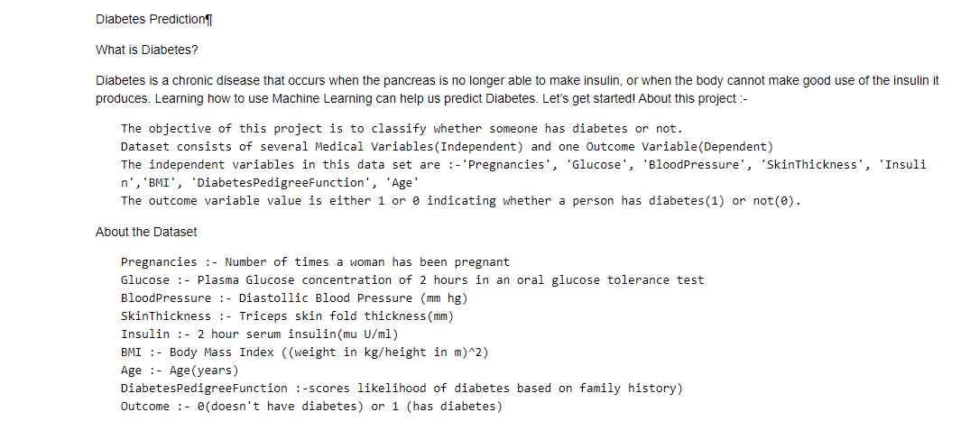
Importing libraries, loading and understanding the data-

Slide 6
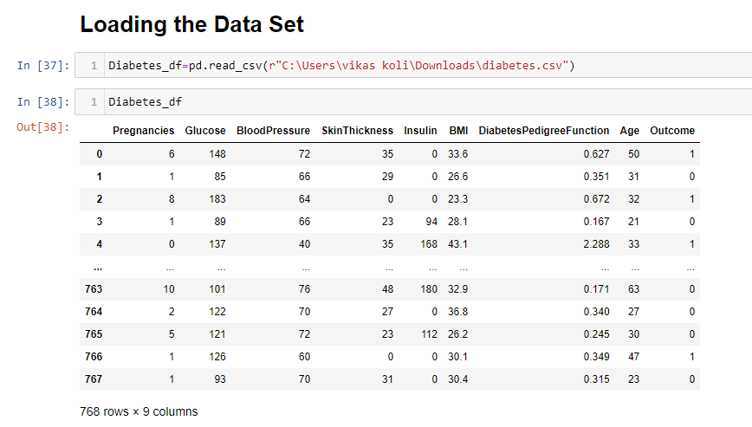

Slide 7
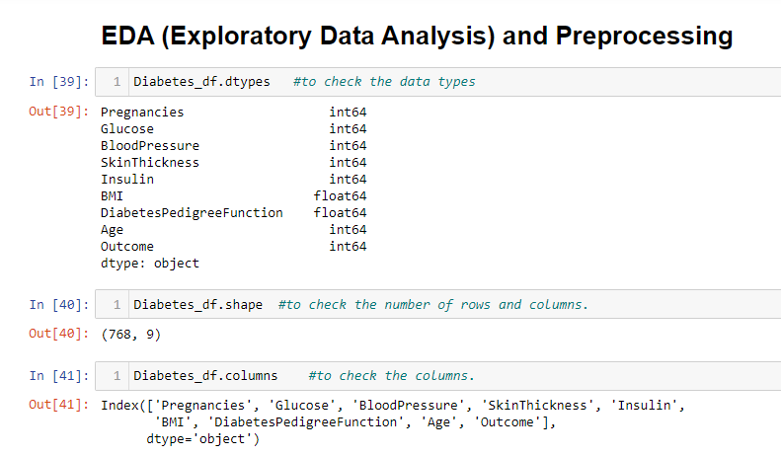

Slide 8
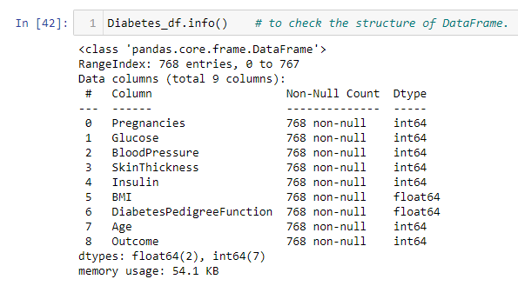

Slide 9
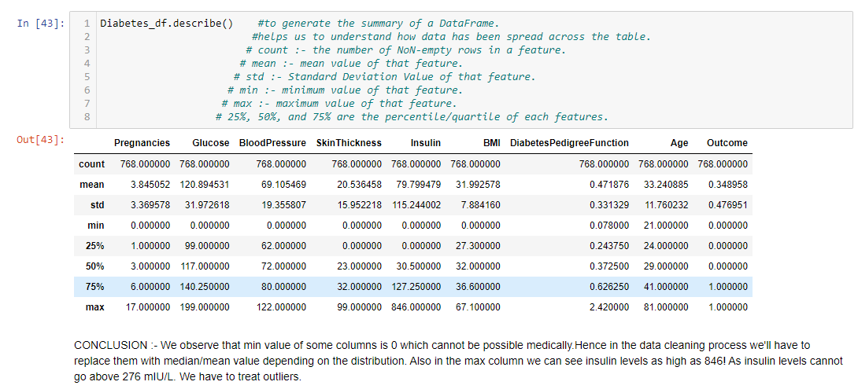

Slide 10
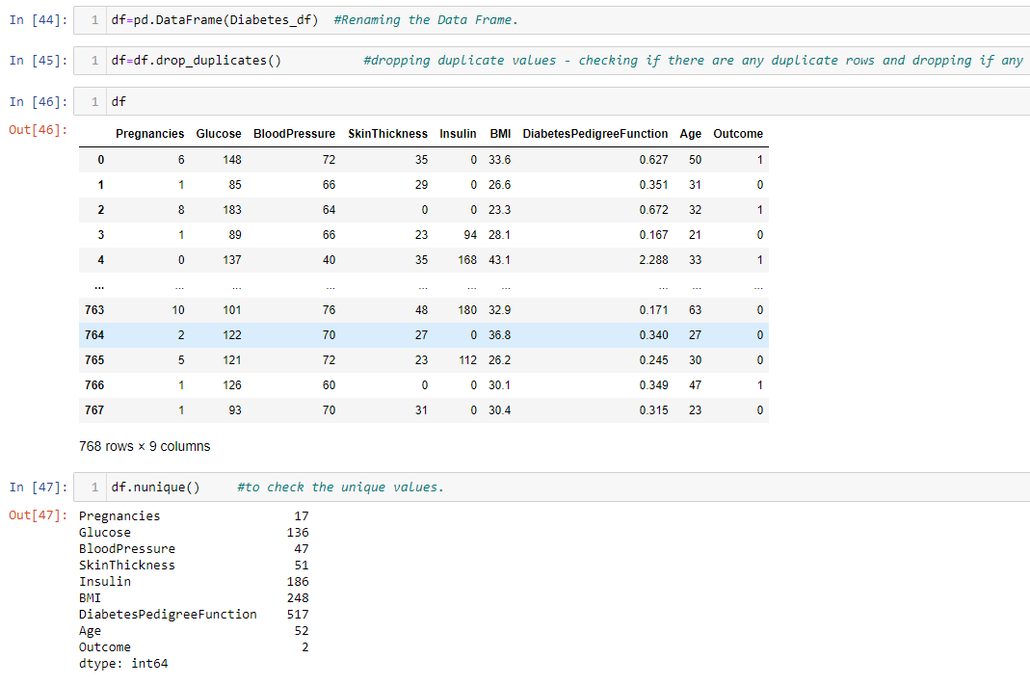

Slide 11
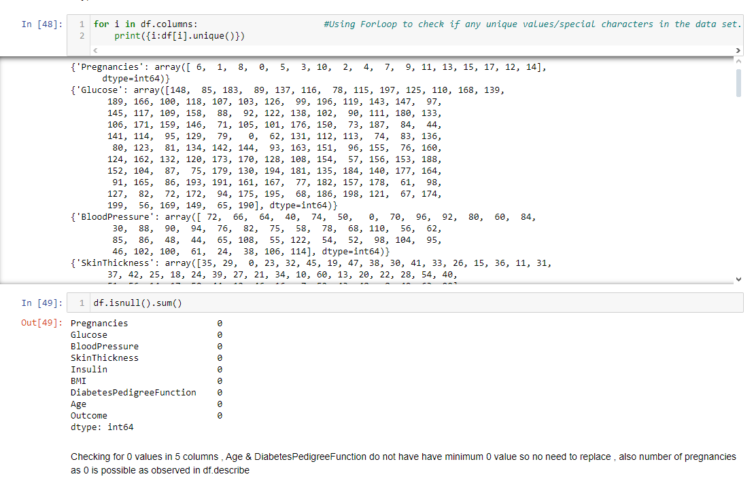

Slide 12
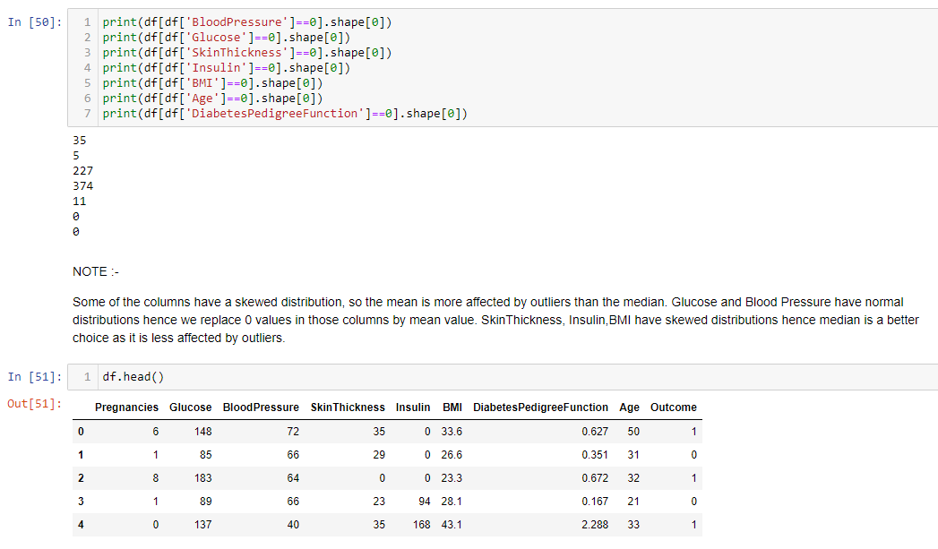

Slide 13
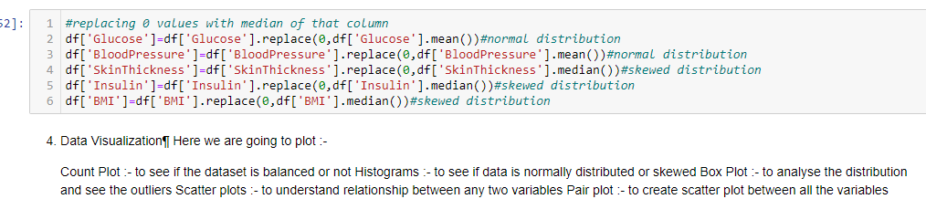

Slide 14
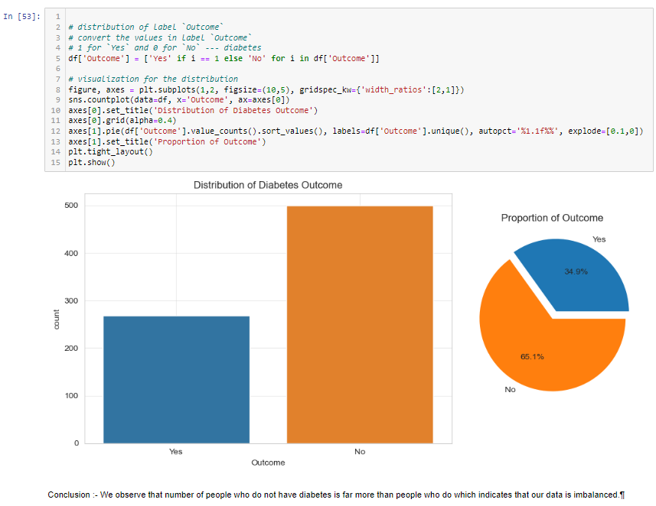

Slide 15
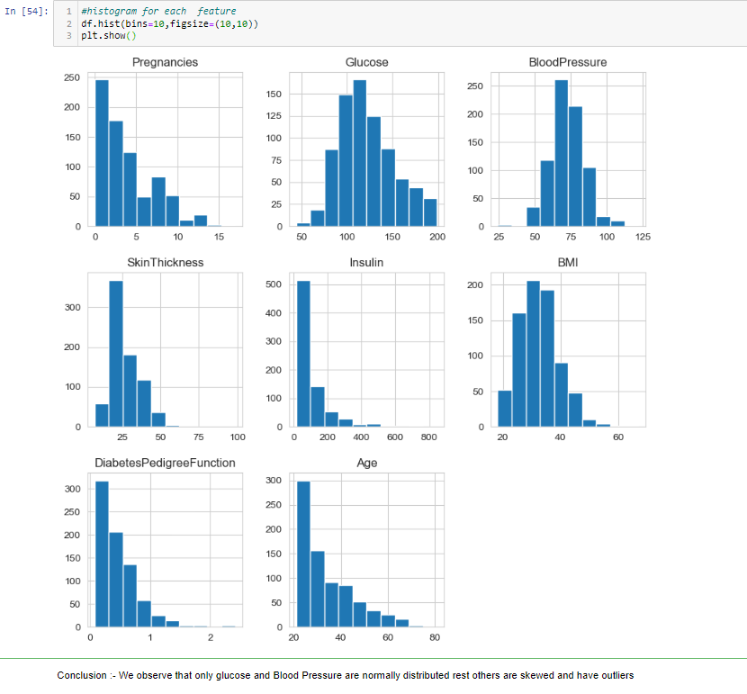

Slide 16
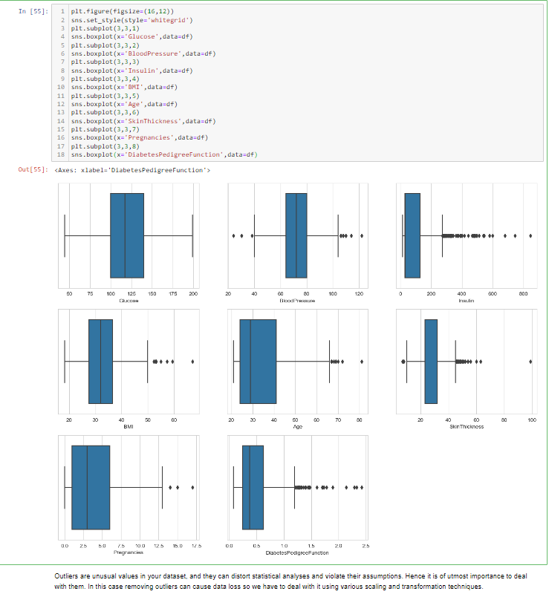

Slide 17
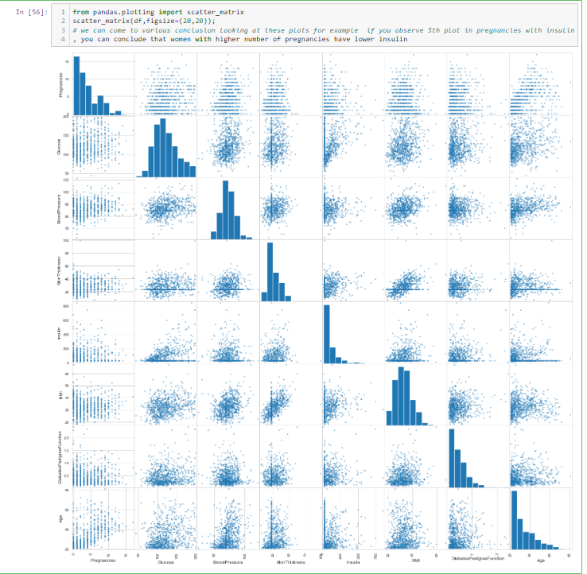

Slide 18
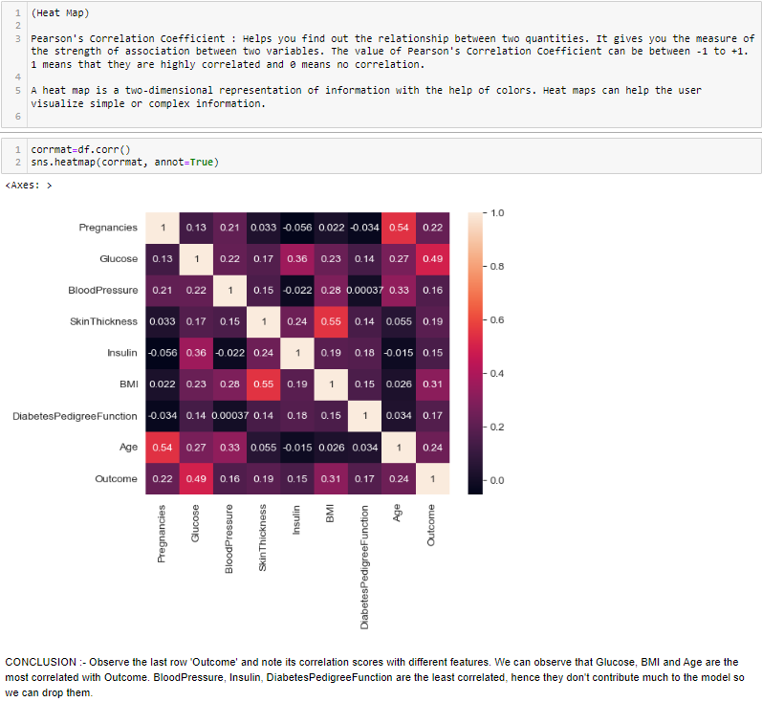

Slide 19
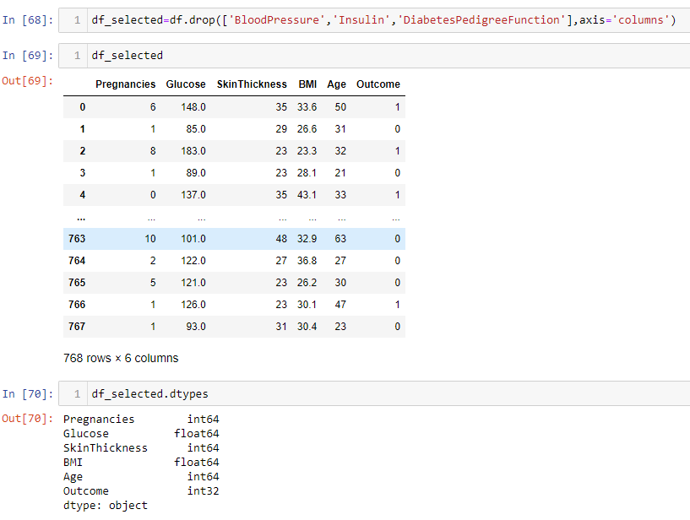

Slide 20
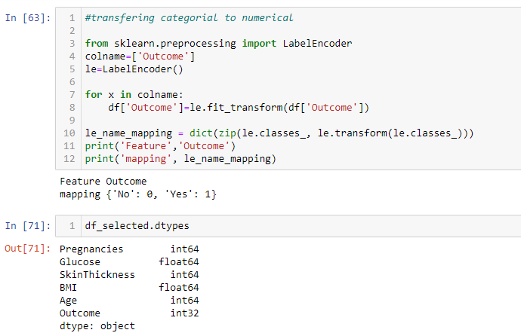

Slide 21
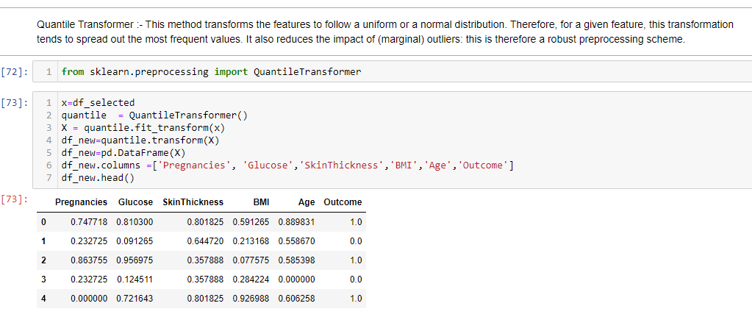

Slide 22
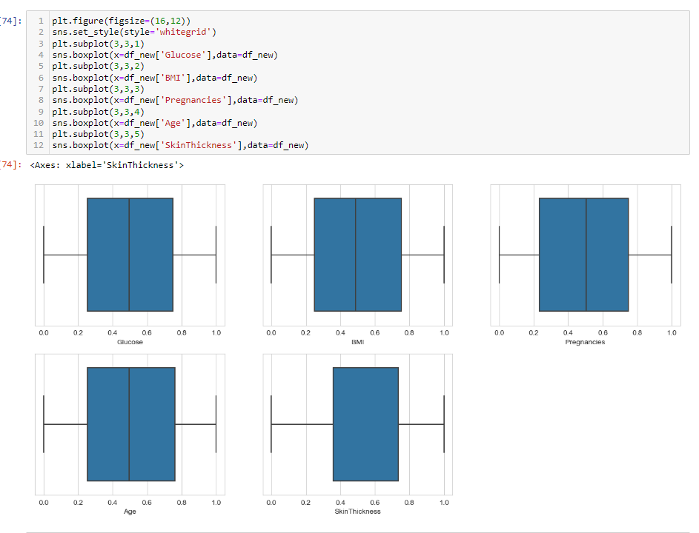

Slide 23
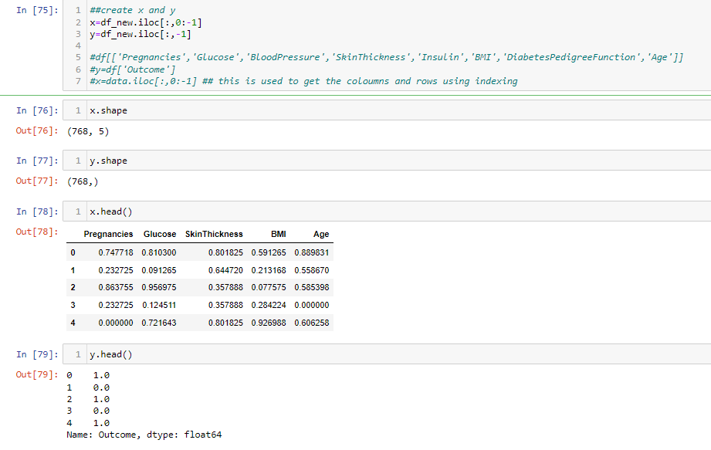

Slide 24
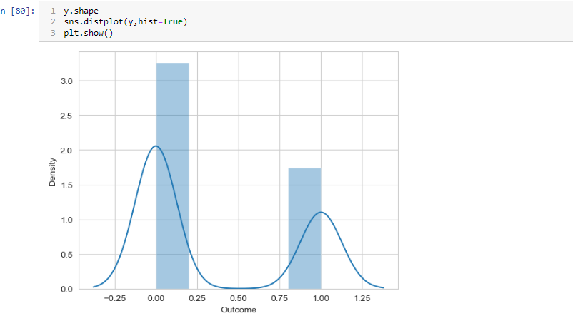

Slide 25
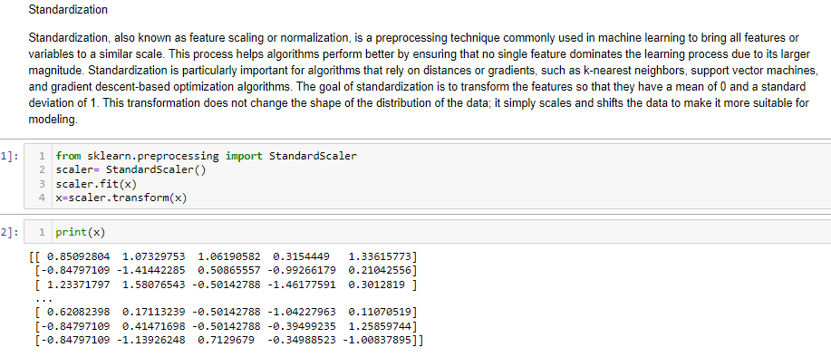

Slide 26
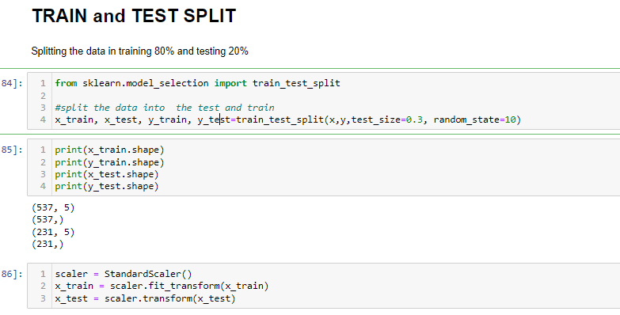

Slide 27
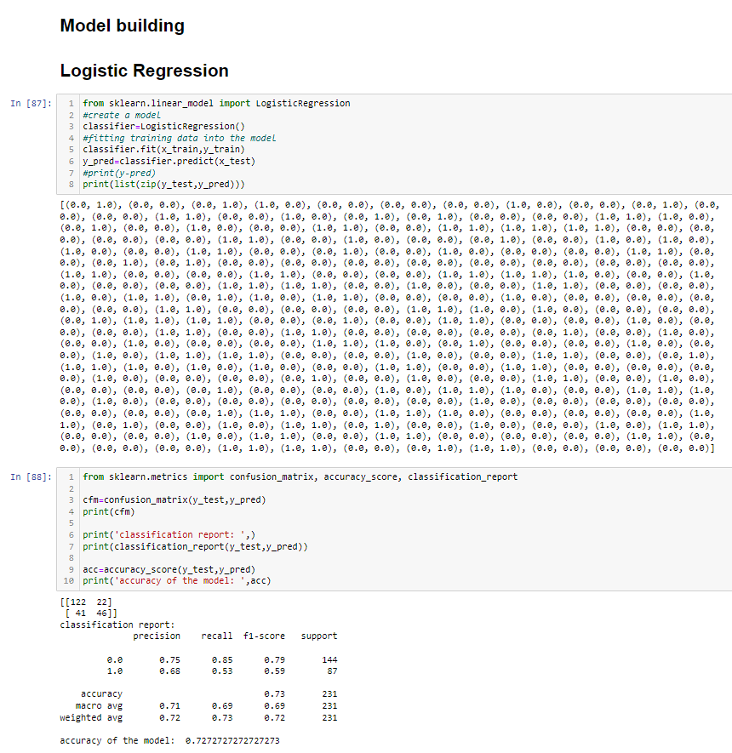
Accuracy Of Model Using Logistic Regression Is 73%

Slide 28
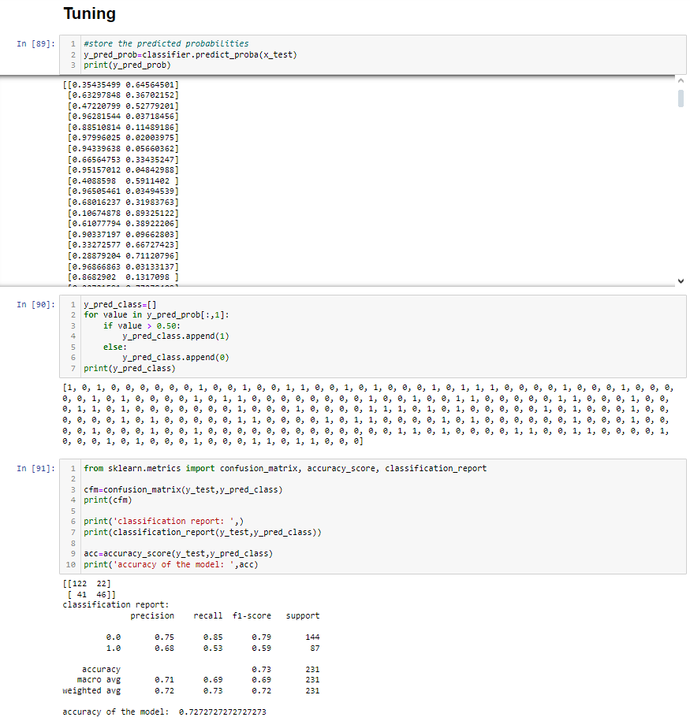
Accuracy Of Model after Tuning Is 73%

Slide 29
Understanding Probability Threshold:
In logistic regression, the model predicts the probability of an instance belonging to the positive class. By default, if the predicted probability is greater than or equal to 0.5, the instance is classified as positive; otherwise, it's classified as negative. This threshold of 0.5 is a common choice, but it might not be optimal for all scenarios.

Slide 30
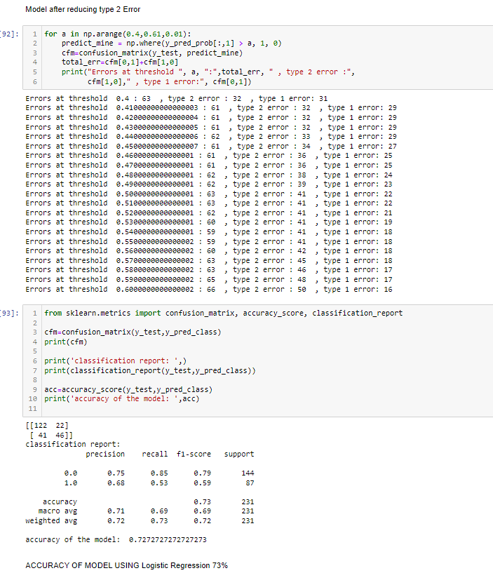

Slide 31
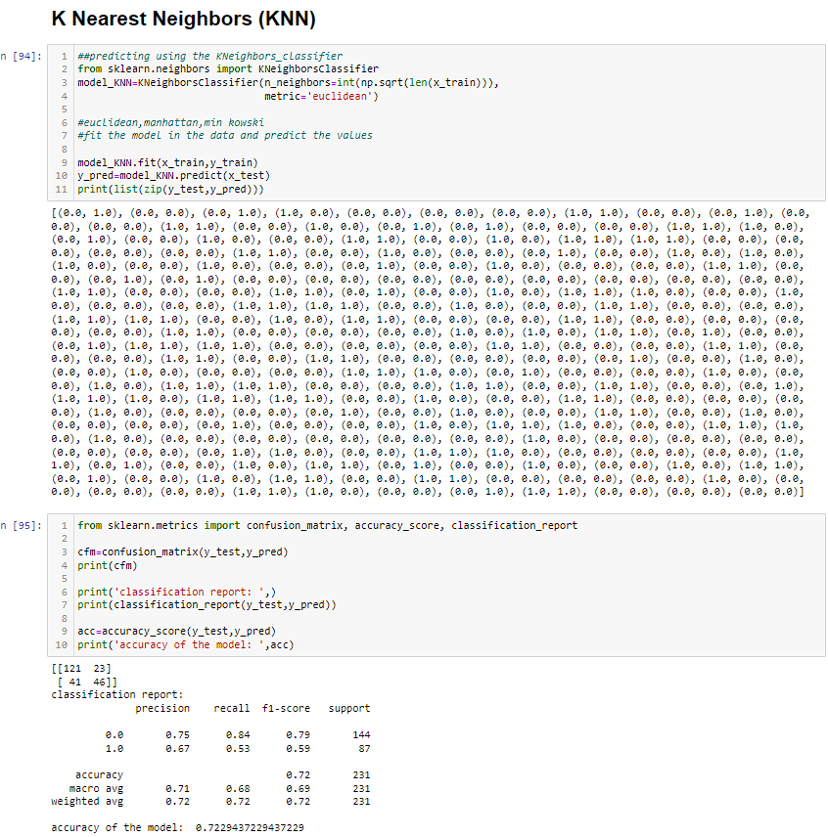
Accuracy Of Model Using KNN Is 72%

Slide 32
Decision Tree Algorithm
A decision tree algorithm is a supervised machine learning technique used for both classification and regression tasks. It works on checking up the impurities based on Gini Index and Entropy which can be applied to a wide range of problems.

Slide 33
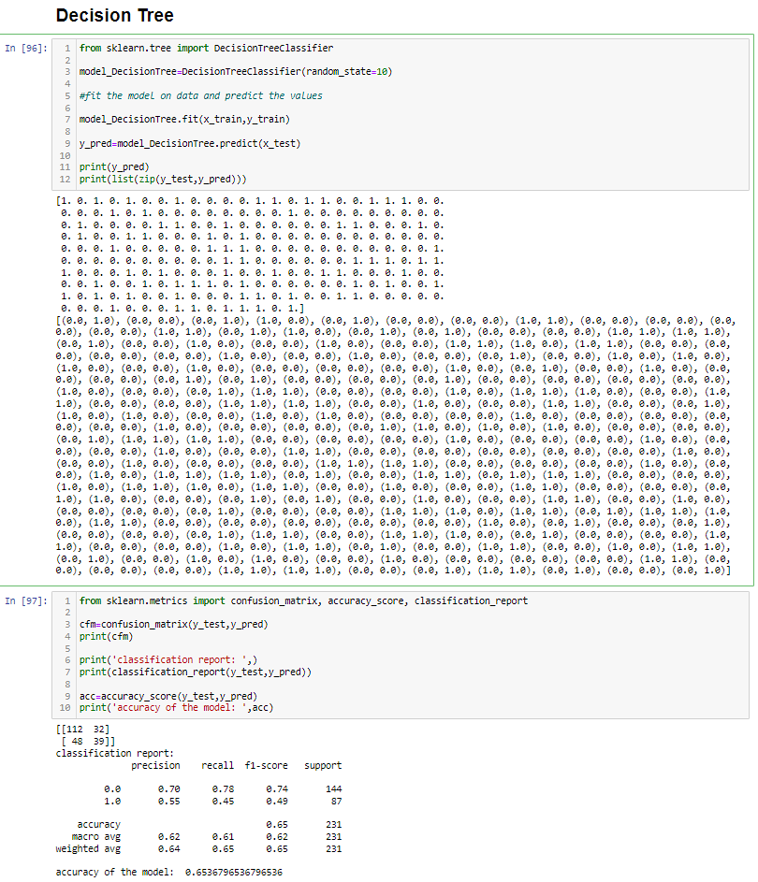
Accuracy Of Model Using Decision Tree Is 65%

Slide 34
Random Forest
Random Forest is a powerful ensemble learning algorithm used for classification and regression tasks. It's based on the concept of decision trees and combines multiple decision trees to make more accurate predictions.

Slide 35
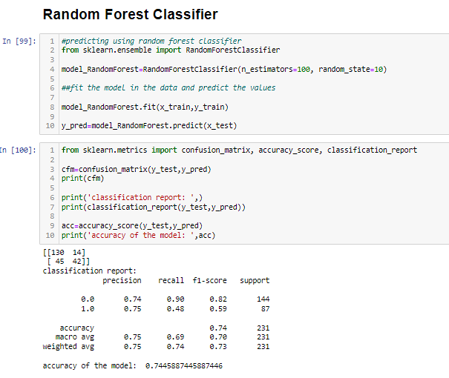
Accuracy Of Model Using Random Forest Is 74%

Slide 36
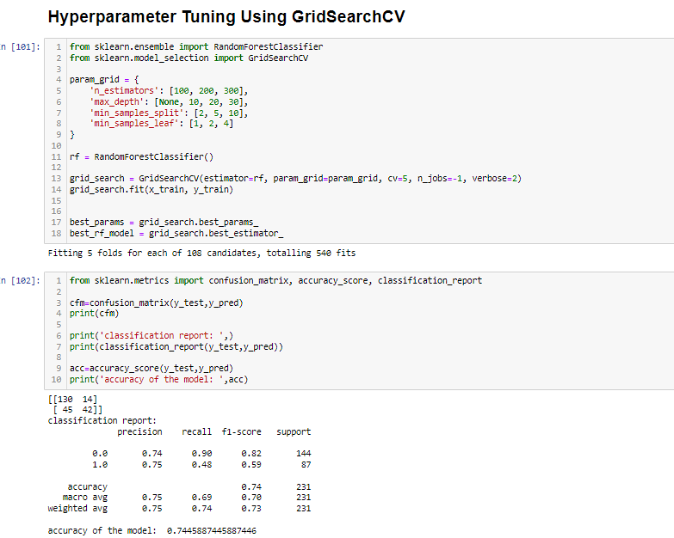
Accuracy using GridSearch CV Is 74%

Slide 37
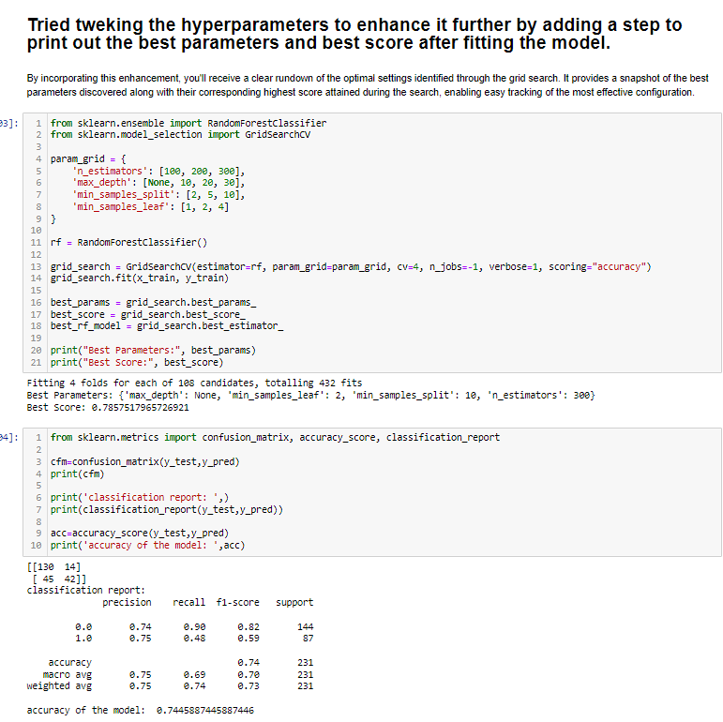
Accuracy Of Model Using Best Parameters Is 74%

Slide 38
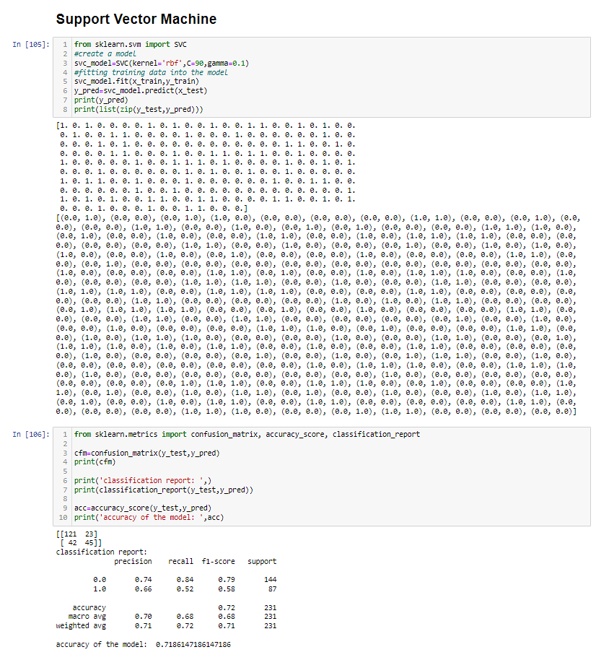
Accuracy Of Model Using SVM Is 72%

Slide 39
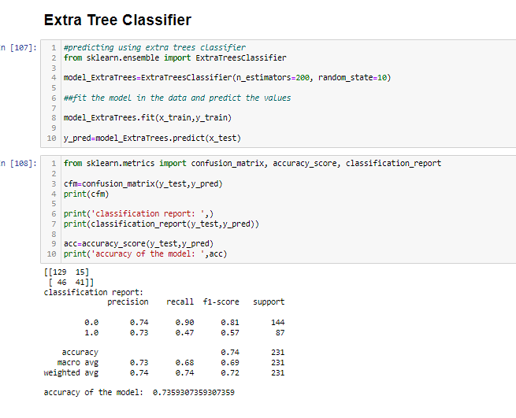
Accuracy Of Model Using Extra Tree Classifier Is 73%

Slide 40
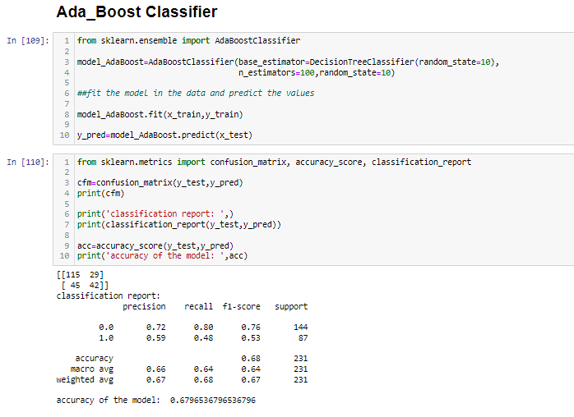
Accuracy Of Model Using Ada_Boost Classifier Is 68%

Slide 41
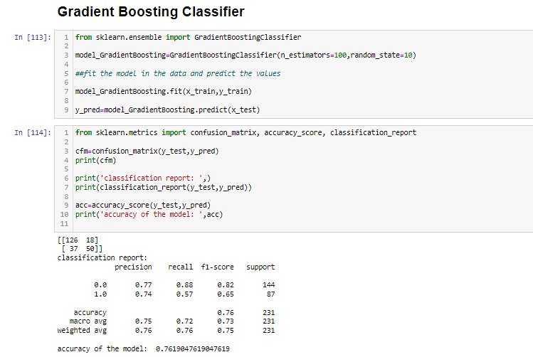
Accuracy Of Model Using Gradient Boosting Classifier Is 76%

Slide 42
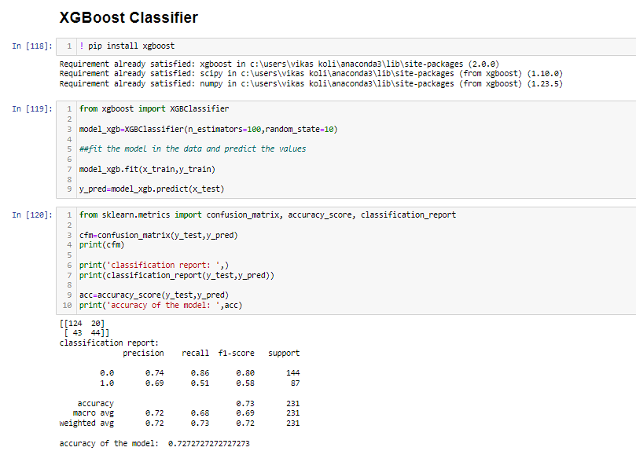
Accuracy Of Model Using XGBoost Classifier Is 73%

Slide 43

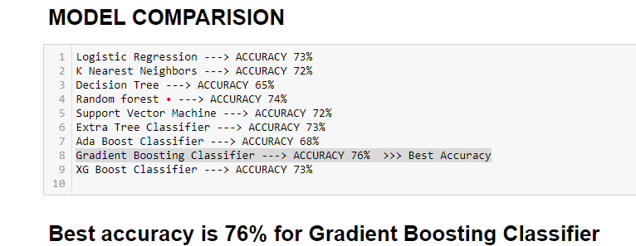

Slide 44
Conclusion:-
All the models mentioned above achieved impressive accuracy, however Gradient Boosting Classifier, an advanced ensemble machine learning algorithm, standing out by delivering the highest accuracy of 76% while also demonstrating the lowest type two error. This achievement is further supported by notable precision (0.74), recall (0.57), and F1-score (0.65) for Class 1 (the positive class). The overall accuracy of 76% reflects the model's strong overall performance in terms of correctness. Taking all aspects into account, it's evident that the Gradient Boosting Classifier Algorithm outperforms the others across the board, making it the preferred choice for this task. Therefore, we will proceed with the utilization of the Gradient Boosting Classifier Model.

Slide 45
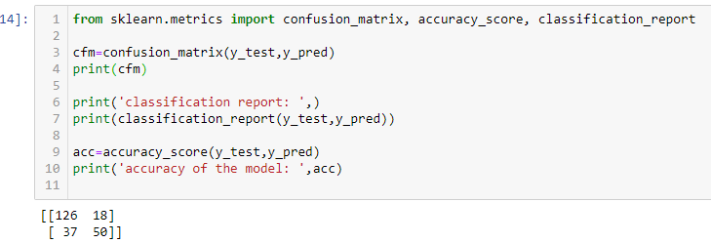
Interpretation of the confusion matrix for Gradient Boosting Classifier
Classification Report:
True Negative (TN): 126
False Positive (FP): 18
False Negative (FN): 37
True Positive (TP): 50

Slide 46
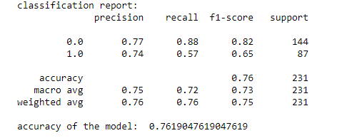
Classification Report for Gradient Boosting Classifier
Precision (for Class 1, positive class): 0.74
This means that out of all the instances predicted as positive, 74% of them are truly positive. It indicates the model's ability to make accurate positive predictions.
Recall (for Class 1, positive class): 0.57
This means that the model correctly identifies 57% of all the actual positive instances. It's a measure of the model's ability to capture positive cases.
F1-Score (for Class 1, positive class):0.65
The F1-score is the harmonic mean of precision and recall. It provides a balance between precision and recall. In this case, the F1-score for Class 1 is 0.65, indicating a reasonable balance between precision and recall.
Accuracy: 0.93
The overall accuracy of the model is 76%, which is the percentage of correctly classified instances out of all instances. It suggests that the model performs well in terms of overall accuracy.
Interpretation:
The F1-score of 0.65 is a balance between precision and recall. It indicates that the model provides a reasonable trade-off between making accurate positive predictions and capturing actual positive instances.
The overall accuracy of 76% suggests that the model performs well in terms of overall correctness

Slide 47
Thank you!!!

